Slide 1
BREAK OUT ACTIVITY 1- CO4

Slide 2
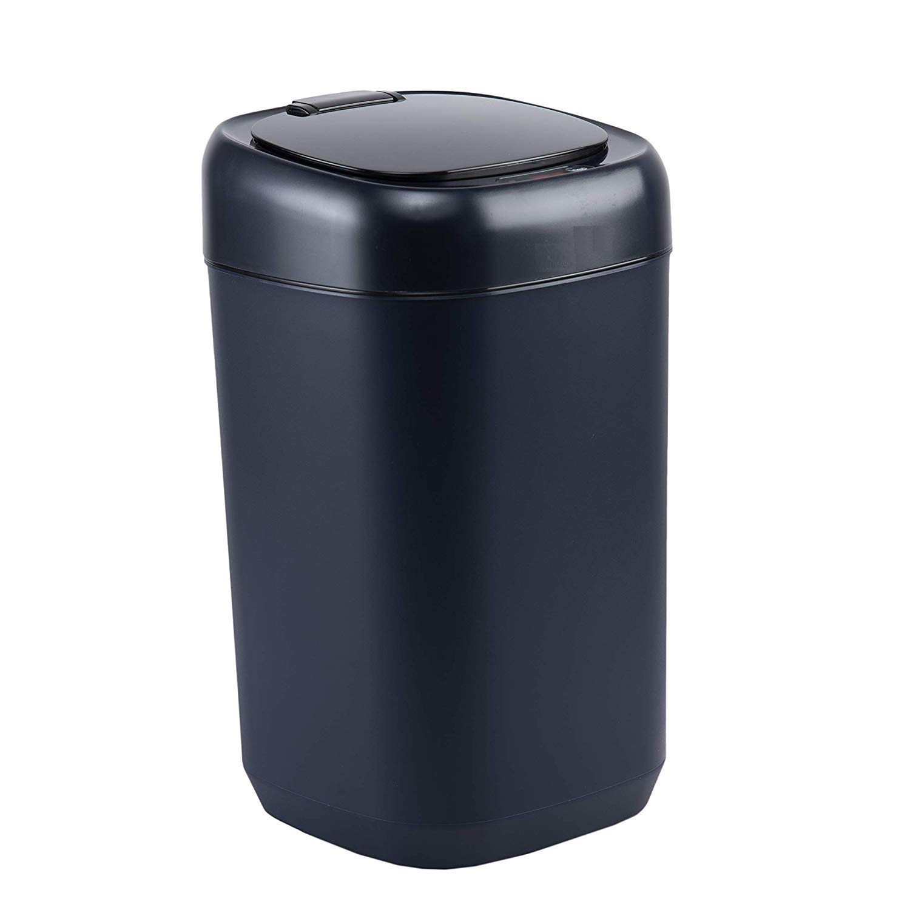
SMART DUST BIN
Which needs a container, and an inbuilt weighing sensor.
Based on the material of product ,it varies from 3 to 5 thousand .
If anyone puts their waste in to the container and it records the weight ,based on that it generates a PIN through a app it sends some vouchers and discounts.

